Slide 1
Smart Weighing Scale
Team Members :
Darshan Krishna (210701046)
Mokeshwaran R (210701516)
Kesarikumaran S (210701324)

Slide 2
Outline
Abstract
Objective
Proposed System & Novelty
Block Diagram
Hardware/Software requirements
References

Slide 3
Abstract
Development and implementation of a smart food scale system utilizing
Arduino and Hexabitz modules.
The Arduino serves as the core processing unit, orchestrating data collection, analysis, and user interaction.
Smart food scale includes
precise weight measurement
a user-friendly interface for inputting food items and
access to an extensive nutritional database for comprehensive dietary analysis.
Wireless connectivity enables data synchronization with mobile
devices and cloud-based services for enhanced accessibility and data
management.

Slide 4
Objective
To develop a sophisticated and user- friendly smart food
scale system that leverages advanced technology to
revolutionize how individuals monitor, analyze, and
manage their dietary intake.
By combining precision, convenience, and accessibility,
the system empowers the users to make healthier
lifestyle choices and improve their quality of life.

Slide 5
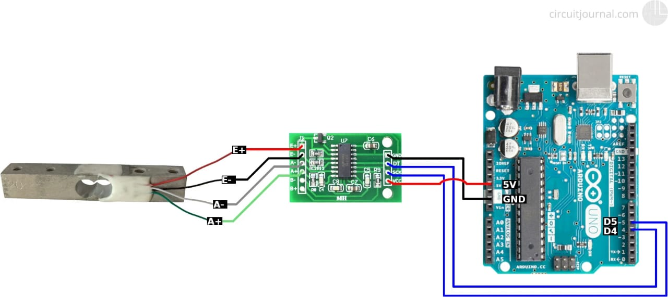
Block Diagram

Slide 6
Proposed System and Novelty
Aims to revolutionize dietary assessment and nutrition management by integrating Arduino and Hexabitz modules to create a sophisticated smart food scale.
This innovative solution combines cutting-edge technology with user-friendly design to empower individuals to make informed dietary choices and promote healthier eating habits.
Hardware Components:
ArduinoHexabitz Modules
Load Cells Display Module
Communication Module
Software Components:
Data Processing User Interface
DatabaseWireless Connectivity.

Slide 7
Hardware/Software Requirements
Hardware Requirement
1.Arduino3 Model B+
2.Hexabitz 4-Pin USB-Serial Prototype Cable
3.Hexabitz Arduino Interface Module (HF1R0x)
4.Hexabitz BitzClamp
5.Hexabitz Load Cell (Strain Gauge) Sensor Module
(H26R00)
6.DFRobot 7'' HDMI Display with Capacitive
Touchscreen
Software Requirement STMicroelectronics
TM32CUBEPROG

Slide 8
References
Arduino Foundation.
Hexabitz Documentation. (https://docs.hexabitz.com/)
Maguire, D. (2013). "Arduino Hacks: Tips & Tools
for Making Things with the Inexpensive Linux Computer," O'Reilly Media
Arduino Forum. (https://www.Ardurio.org/)
forums/)

